Slide 1
Introduction to Incident Response
Cybersecurity
Lesson 21.1

Slide 2

Learning Objectives
By the end of today’s lesson, you will be able to:
1
Identify the types of incidents typically escalated to incident response managers.
2
List who makes up a Security Incident Response Team (SIRT) and their roles.
3
Identify how an incident response plan can guide the SIRT when an incident occurs.
4
Use the malware testing tool ANY.RUN to dynamically analyze ransomware.

Slide 4

Introduction to Incident Response

Slide 5

This week, we will learn about DFIR, which stands for Digital Forensics and Incident Response.
Notes:
shutterstock_1291533214

Slide 6
Incident Response and Digital Forensics Module
Day 1
Days 2-4
Introduction to incident response
Focus on digital forensics
Notes:
#3 Instructor Do
The term digital marketing wasn’t even used before the 1990s (source). Personal computers started becoming popular in the 1980s, but the advent of the internet in the 1990s is what pivoted the direction of marketing. Even into the early 2000s, marketers largely relied on traditional channels to promote their wares.

Slide 7

Intro to Incident Response
We have covered various threats that can negatively affect a company, including:
Malware
DDoS attacks
Botnet attacks
Phishing
Data breaches
Notes:
Shutterstock : 2467103999

Slide 8
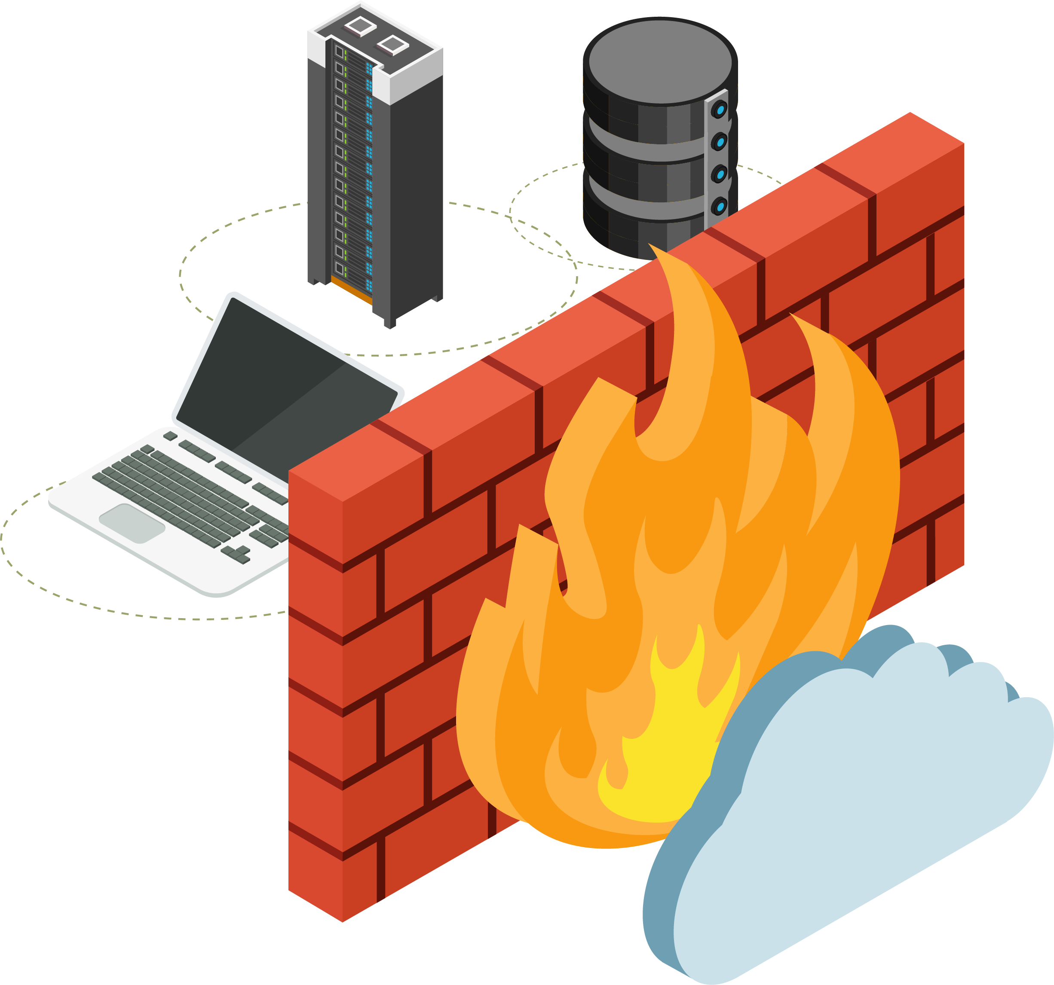
Intro to Incident Response
Companies put in place security systems
to prevent these incidents, such as:
System firewalls
Intrusion Prevention Systems (IPS)
Network security firewalls
Application security

Slide 9
Incident response is a procedure that an organization uses to react, mitigate, and respond to a security problem.

Slide 10

Intro to Incident Response
If we think of a company as a bank,
its security systems are similar to the bank’s alarm and security guards.
We can consider the threats to be bank robbers, and the incident response to be like the police responding after the bank alarm
went off and the robbers broke in.

Slide 11

SIRT Structure

Slide 12
In order for an organization to manage these security incidents, they need an organized team to respond to them. This team is known as the Security Incident Response Team (SIRT).

Slide 13

SIRT Structure
Most SIRTs are typically made up of the following roles:
Security operations staff
Incident responders and
incident response managers
Aligned staff:
  Legal
  Compliance
  Communications, PR
  Engineers
Notes:
https://www.pexels.com/photo/top-view-photo-of-people-near-wooden-table-3183150/

Slide 14
First responders to handle security issues work out of a security operations center, or a SOC.

Slide 15
Security Operations Center (SOC)
Within a SOC are SOC analysts who are often organized in three tiers:
Tier 1
Tier 2
Tier 3

Slide 16

SOC Staff
Tier 1
Junior analysts are the first responders and first line of defense.
Often in charge of monitoring alerts and verifying that they are not false positives.
Follow pre-planned procedures, perform an initial investigation, solve simple incidents, and escalate as needed.
Entry-level role and starting point for most students who choose this career path.

Slide 17

SOC Staff
Tier 2
Tier 2 is the first escalation point for Tier 1 analysts:
Help get past any blockers that the Tier 1 analyst may have.
Can perform the duties of Tier 1 as needed,
but can also divert from written procedures.
Also support Tier 3 as needed, and create documentation and procedures for Tier 1
and monitor Tier 1’s performance.

Slide 18

SOC Staff
Tier 3
Tier 3 is the second escalation point for
Tier 1 analysts and may serve more of
a forensics or deep investigative role:
Often own the tools used by the incident response team.
Oversee complex incidents.
Mentor and monitor the performance
of all other tiers.

Slide 19

SOC managers can perform all of the duties of a Tier 3 analyst, but also manage the team and have the HR responsibilities of growing and maintaining the team.

Slide 20
SOC staff responsibilities include determining if a security issue is considered to be a high priority incident that requires an incident response manager to intervene.

Slide 21

Security Operations Center (SOC)
Analysts are typically provided with directives as to what type of incident requires escalation.
There will be many times when analysts will encounter unique issues that will require their professional judgement.
Issues that can impact the entire organization technically, financially, or reputationally usually require escalation.

Slide 22
A SOC analyst determined that one employee had their account breached, the employee had data of all the organization's customers obtained by the attacker.
Does this situation require escalation?

Slide 23

Escalation or not
You are a SOC analyst working for a financial services organization.
There have been multiple security issues at your organization.
Your task is to review the following issues and determine if these require escalation to the SIRT.
20 minutes

Slide 26

Incident Response Plans

Slide 27
This next section will cover what takes place after the SIRT has been assigned to an incident.

Slide 28
Incident Response Plans
Let’s cover some important terms used by the SIRT:
Bridge (Bridge Call) | Conference call or communication channel where the SIRT discusses a specific security issue.
Incident Response Plan | Formal high-level document detailing how the organization will respond to incidents.
Response Process | More general document not as formal as an incident response plan.
Response Procedure | Step-by-step workflow for a given part of a response often organized in a flowchart.
Incident Response Playbook | Collection of procedures for a given type of incident.

Slide 29
Incident Response Plans
Let’s cover some important terms used by the SIRT:
Root Cause Analysis (RCA) | Process or report that determines the root reason why the incident occurred.
Post-Incident Report | Process and document designed to provide an overview of what the analyst found and what they did in response to a particular incident.
Tabletop Exercise | Common exercise where a security team is given an incident scenario and they detail the steps they would take to respond to it.

Slide 30

SIRT First Steps
Now that we know the terms used by the SIRT, let's get into the incident response process.
A common first step taken by an incident response manager is to open a bridge.
All required teams that understand the issue will be invited.

Slide 31


SIRT First Steps
Subject matter expert (SME)
Next, the incident response manager will have a SME explain the issue and its potential impact.
The SME will determine if
the issue could potentially
be a false positive before
escalating further.
An incident response manager may not be an expert on every possible incident. It is very common to call in a SME to assist in the response effort.

Slide 32

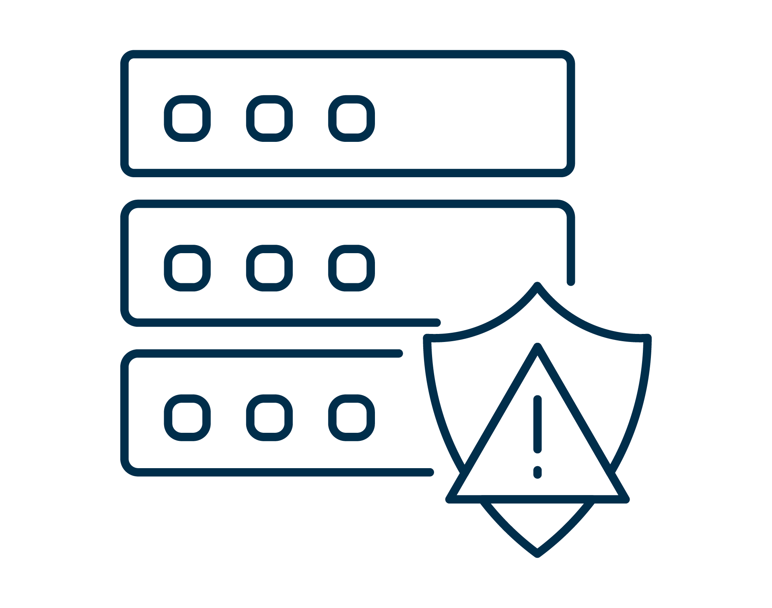
Simple Incidents
Complex Incidents
Phishing attacks
or malware downloads
Usually opportunistic attacks that can be solved by junior analysts following specific steps.
Attacks that affect multiple employees and/or servers
More coordinated attacks that have
a higher severity. May involve multiple incident response team members and/or multiple IT teams.

Slide 33
The next step of incident response is putting a plan of action in place.

Slide 34

Incident Response Plans
Every company should have a documented plan
An incident response plan should cover:
When to respond
What to do and how to do it
Who is in charge
Organizations should also have different response plans for different incidents, like
Data breaches
DDoS attacks
Application security vulnerabilities

Slide 35

Incident Response Plans
An incident response plan should help cover the process that needs to be followed and answer these common questions:
Do you immediately take systems offline and just send a notification?
Who makes the decision to shut down systems?
Do you need management approval to shut down systems?
Who needs to be notified?
Will this affect company revenue or customer experience?
At what point do you involve the PR department?
At what point do you involve the legal team?
Who communicates the issue to the executive team?

Slide 36
Interpreting incident response plans
In this activity, you will compare and contrast several incident response plans from different companies.
This activity is meant to provide an overview of real-world incident response plans from companies in different sectors and industries.
Try not to get overwhelmed by the volume of these documents. Focus your attention on each document's table of contents and
one section of your choosing to compare across the documents.
40 minutes

Slide 40

Developing an Incident
Response Plan

Slide 41
If you had to write an incident response plan for your company, it would be useful if there were some kind of standard framework that your organization could follow.

Slide 42

Developing an Incident Response Plan
The National Institute of Standards and Technology (NIST) sets the industry standard for incident response plans.
It offers a detailed plan and process descriptions for everything involved in an incident.
Companies can also use the NIST standard as a framework for building out their own plans.
An incident response plan must be continually executed, assessed, and updated to keep up with current threats.

Slide 43

Incident Response Playbook
An incident response playbook lists the steps that need to be taken to respond to security incidents.
It can be split into various procedures. The common
phases of an incident response playbook include:
Prepare
Detect and analyze
Contain, eradicate, and recover
Post incident

Slide 44

Incident Response Playbook
Phase 1: Prepare
Identify key contacts and steps taken before any analysis takes place. The prepare phase often includes determining and documenting the following:
Systems, network diagrams, and baselines
Clean OS and application images available
How to handle hardware and software
Who is going to monitor and who is going to respond
Key stakeholders and their contact info

Slide 45

Incident Response Playbook
Phase 2: Detect and analyze
Validate, identify, and prioritize the issue.
The detect and analyze phase often includes determining and completing the following:
System logs and IDS/IPS system alerts
Anti-virus software alerts
Host-based monitor detecting configuration change
Network traffic anomalies
Characteristics and indicators of a threat
Business impact
Incident priority

Slide 46

Incident Response Playbook
Phase 3: Contain, eradicate, and recover
Prevent the issue from worsening by removing and
stopping it while recovering all business capabilities.
The contain, eradicate, and recover phase includes:
System isolation
Disabling breached user accounts
Replacing compromised files
Determining affected systems
Identifying attack tools, methods, and vectors
Communicating needed actions with teams
Verifying incident has been removed with updated monitoring
Recovering affected systems or restoring from backup
Determining steps that should be taken on affected servers or systems
Erasing systems, firewall updates, patches etc.

Slide 47

Incident Response Playbook
Phase 4: Post incident
Understand the specifics of what caused the issue, and how to improve on future responses and mitigate future issues. The post incident phase includes:
Learning and improving
Holding post-incident meeting
Reviewing detailed timestamp of events
Re-evaluating incident response plan
Updating system alerts to ensure better accuracy
Reviewing changes applied
Updating response workflow
Documenting and reporting

Slide 49

Responding to a Malware Incident
With ANY.RUN

Slide 50

Responding to a Malware Incident
Many organizations are concerned with malware infections
If a hospital were infected by ransomware,
it may be unable to access medical data, which could affect the health of its patients.
Organizations are often challenged with how to respond to incidents when malware has potentially infected their network. Common questions they should ask include:
How and when was the user or machine infected?
Were any other users or machines infected?
What was the impact of the malware?

Slide 51
Responding to a Malware Incident
Running live malware is inherently dangerous, so analysts need to use special environments.
Static Malware Analysis Tools
Dynamic Malware Analysis Tools
Analysis of raw source code.
Look for things like IP addresses (reveal C2 servers), ports, processes
Analysis of what the malware does when it runs.
Look for things like Wireshark captures to identify "phoning home" (communication with C2 servers), suspicious changes to the file system or registry, etc.

Slide 52
In this lesson, we will learn how to use the dynamic malware analysis tool ANY.RUN.

Slide 53

Responding to a Malware Incident with ANY.RUN
ANY.RUN is a web-based dynamic malware analysis tool.
It can provide:
An interactive sandbox where a security engineer can view how the malware responds to different scenarios.
Insights into how the organization may
or may not be impacted.
Network details showing how the malware communicates by identifying
IP addresses and suspicious domains.

Slide 54

Demonstration Scenario
We will use the ANY.RUN tool to analyze the Adylkuzz malware.
Adylkuzz is a cryptcurrency mining malware that hides in the background and uses a computer's resources to mine the digital currency Monero.
Notes:
shutterstock_1888488028

Slide 55
ANY.RUN

Slide 56
Analyzing ransomware with ANY.RUN
In today's final activity, you will play the role of an incident responder tasked with analyzing malware that has infected a user’s computer at your organization.
You are tasked with safely analyzing the malware and completing
a report about the impact of the incident to your organization.
30 minutes

Slide 59
Introduction to digital forensics

